Slide 1


Get your Swag On with Design-Time APIs
APIs WITHOUT CODE

Slide 2
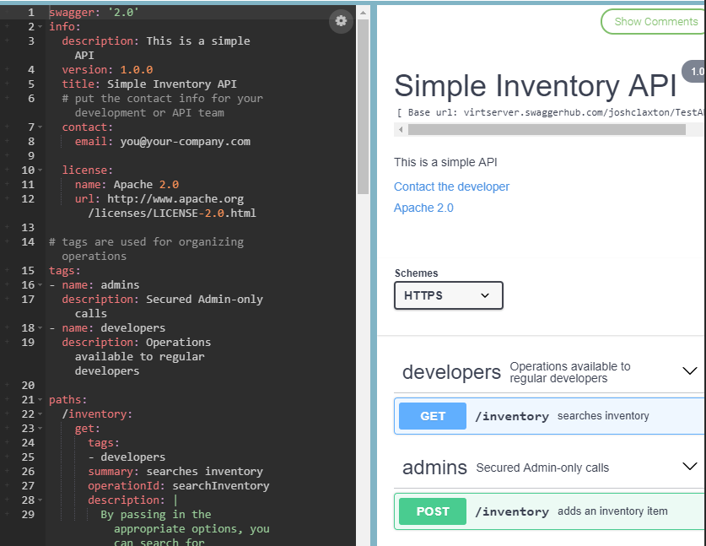
Design Time APIs: APIs without Code
HTTP GET /APIGuidelines
HTTP GET /DesignTimeAPIs
HTTP POST /Demo
{
"Content": [
"Design",
"Mock",
"Test",
"Code Generation"
]
}

Slide 3
API Guidelines
Rules for creating rules

Slide 4
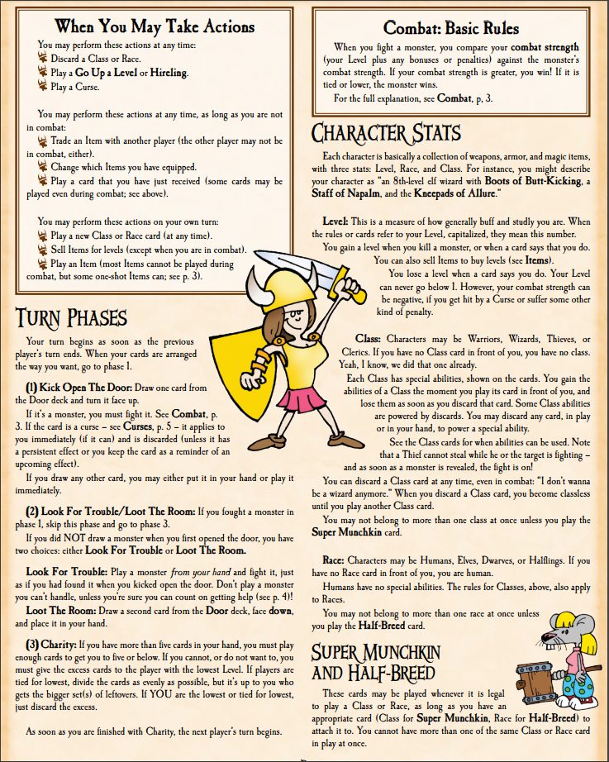
What is the purpose of an API?
A contract describing a set of rules that allow software applications to communicate with each other.
WebAPI/REST
WCF Services
NuGet Package
Angular, Knockout, JQuery
Git CLI
We will focus on REST(ish) APIs

Slide 5
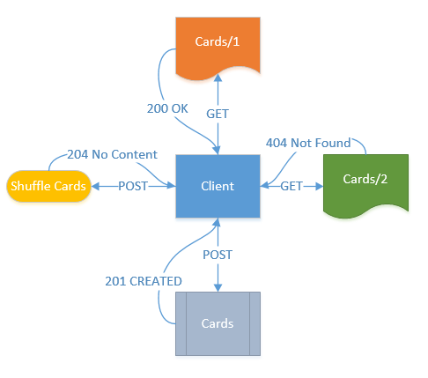
REST(ish) API Guidelines
Use Resources
Except when methods make sense
It’s a language
Use HTTP Verbs and HTTP Codes

Slide 6
REST(ish) API Guidelines
Verb | Definition | Example Response
GET | Retrieve Data | 200 (OK)
POST | Add New Data or Do Something | 201 (Created), 200 (OK), 204 (No Content)
DELETE | Delete Data | 200 (OK), 204 (No Content)
PUT | Update Data | 200 (OK), 204 (No Content)
Properties
Safe, Idempotent, Cacheable
Idempotent
Idempotent
Safe – Free of side-effects (that the caller is responsible for)
Idempotent – Can be called multiple times without changing the result
Cacheable – Result of request can be cached
Notes:
Verbs, codes, language
Properties
Resrouces and locations

Slide 7
Examples
EventBroker API
Vehicle API

Slide 8
Design Time APIs
…huh?

Slide 9
Approaches to Creating APIs
Just code it
Traditional
Code
Feedback
Code
Feedback
Design
Design Time
Design
Feedback
Code
Notes:
Level 1 (DT, sometimes)
It’s easy, I’ll just code it.
Level 2 (DT)
I’ll wait to code it until after I design it on paper to match the use cases.
Once it is coded, I’ll let QA and other developers use it.
I’ll fix the code as the give me feedback. Repeat this.
Level 3
I’ll use a tool to define my API.
Before I code it, I’ll let QA and developers use it.
I’ll fix the design as the give me feedback. Repeat this.
Now I code it, once.

Slide 10

Design Time
Typically, we have used Swagger to create a UI after we code up the API.
Instead we’ll use Swagger to design the API, then code it to the spec.
Notes:
Swagger Hub
Show the UI to get people comfortable
Explain YAML and the markup
Show how the markup matches up to the UI (comments, model, etc.)
Show using the api
Show using the api without swagger
Import the swagger into post man
Create a .net server (use the one I have already downloaded and opened)
Create a typescript angular client (use the one I have already downloaded and opened)

